Slide 1
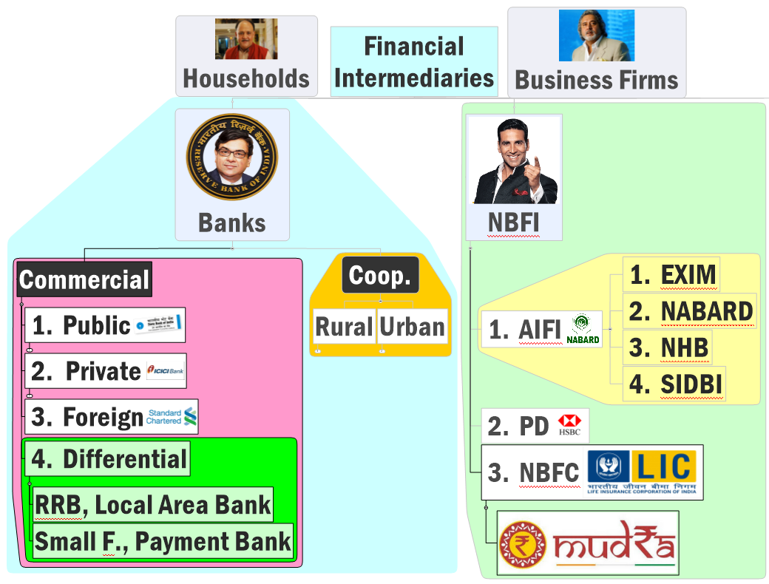



Slide 2

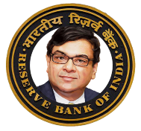


Primary dealers?
Financial Market
Money Market
Capital Market
Primary
Secondary
Long term 1/> year
Short term <1 year
Govt: T-Bill, CMB
Firms: C-Paper, Promissory note
Banks & FI: Cert. of Deposits
Govt: G-Sec, S-Bonds
Firms: IPO, Shares, Bonds, Debentures
Securities resold here

Slide 3


Primary dealers
NBFI
deal in "primary" market. directly buy G-sec during "auction“ at RBI’s E-Kuber platform, and sell it in the secondary market.
Can Participate in OMO <Lecture Video LINK>
Must get license from RBI.
Goldman Sachs, JP Morgan Chase, Standard Chartered Bank, HSBC (Hongkong and Shanghai Banking Corpn. Ltd)
Even: SBI, BoB, Kotak Mahindra etc.
21 PD: 14 Banks + 7 Non-Banks [as of 31st March 2016]
Primary Market
Secondary Market

Slide 4

Regulator
Regulator

Slide 5
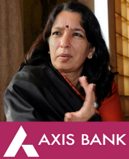
Define “Bank”?
FI: that provides Deposit and lending services to “Public AT LARGE”.
Deposit services
Money. [not goods, not non-money assets. Safe Deposit vault is “auxiliary service”]
Accepts from public @large. [not just shareholders or selected “subscribers”, “policy holders”]
Deposits are Repayable @Time (FDRD) and @Demand.(CASA)
Lending Services
Direct lending: to Public at large.
Indirect lending: NABARD/SIDBI funds when fail to meet PSL targets.
Auxiliary services:
Safe deposit vault,
foreign exchange conversion,
tax payment,
sale of mutual fund, pension, insurance policies,
Investment advice, underwriting.

Slide 6



Bank vs NBFC
Registration
Banking Regulation Act
Companies Act
Supervision
RBI
Insurance Company: IRDA, Mutual funds-SEBI..
Deposits
Time & Demand [chequable deposit]
Only Time. (NBFC-D)
Chequebook
Yes, Payment Settle Act’07, CTS
No. Only “TIME Dep”
Entry Capital
500 Cr.
5cr for MicroFin, 2 cr for others; 200 cr. For reinsurer
Reserve Ratio
4% CRR, 20.5% SLR
NBFC-D: % SLR.
But arrange funds by borrowing from banks (Microfin), client (LIC, MF), capital market, ECB

Slide 7
Mock question
Sources of NBFC’s funding are:
Bank borrowing
Commercial Papers, Bonds, Debentures
ECB in rupee denominated bonds
All of above.

Slide 8


What to do with incoming Money?
Loan Rate
MCLR
Gold Loans 15-25%; invest share/ bond%
Loan recovery: SARFAESI?
Yes DRT -> attach assets
only house-fin; Gold auction, share- bond-liquidation..
Invest
Not in share market. (MF separate)
Can do.
Type
Bank
NBFC

Slide 9





NBFC classification: based on Regulator
NBFC
Who regulates?
RBI
SEBI
Dept company Affairs
IRDA
NHB
FMC

Slide 10
NBFC classification-> RBI controlled
Asset Finance Company (AFC)
loan for economically productive assets e.g. truck, tractor, pumpset, bulldozer
Infrastructure Finance Company
Gives loan for infra. Projects. (IDFC got separate bank license)
SREI Equipment Finance (WHITE LABEL ATM)
Rural Electrification Company ltd. (REC): DD Gram Jyoti Yojana; PSU under Power Min.
Infrastructure Debt Fund (IDF)
Long term loans to highway / port developers
Investment Co.
Core investment [Tata / Birla Cap]
Borrow-> Invest in securities /funds.
Muthoot finance; L&T finance.
Long term investment, not speculative,
Can accept time-deposit, forbidden from insurance
Loan Company | Muthoot gold loan, Mannapuram Gold
Factor Company | Factoring business HSBC
Chit Fund | RBI + Registrar of Chit fund. <more in finance Lecture>
Micro finance | RBI + Dept Corporate Affairs
Residuary | --

Slide 11
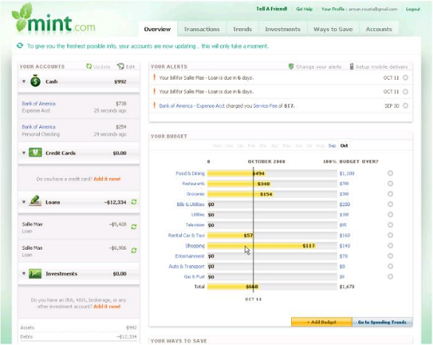
RBI controlled Latest category: NBFC Account aggregator
Show to client
Show to loan giver
NBFC: AA
Bank balance
MF: return on assets
RBI
SEBI
NPS: investment
PFRDA
Insurance Policy
IRDA

Slide 12

Latest entrants
NBFC-account aggregators (AAs)
P2P Lending & similar FINTECH cos.
Regulation structure yet to work out. Delayed by demonetization
AA collect and provide information about a customer’s financial assets to customer or third party (say for loan passing)
LATEST entry in RBI list: draft guideline- RBI act & companies Act get registered, min cap 2 cr;
Quickr/olx like platform for meeting of lenders/loans-seekers.
CASA,FD,PPF, NPS, Life insurance, MF…so how to see consolidated overview of my financial assets under different regulators?
Faircent, ilend etc.
Notes:
NBFC
Total 209….even more stringent norms.
Latest category (2016, Sep)
NBFC-account aggregators (AAs) …yes. They collect and provide information about a customer’s financial assets when entity fall under different financial regulators. e.g. Reliance payment Bank + reliance mutual fund.
Peer to Peer lending..yet to bring under regulatory ambit.

Slide 13

NBFC classification: based on Regulator
NBFC
Who regulates?
RBI
SEBI
Dept company Affairs
IRDA
NHB
FMC

Slide 14
SEBI controlled NBFCs
Stock Broker, MF
Indiabulls, Sherkhan, Reliance Money
They help buying-selling of shares (of their clients).Earn commission/brokerage) in between.
Investment Banks: (US term)
Merger, acquisition, Wealth Management; Underwriting.
Kotak Mahindra, Citigroup,Bank of America
Merchant Banking Companies: (UK term)
Underwriting, Corporate advising, equity finance
DSP Merrill Lynch, Morgan Stanley, Canara Bank, SBI capital (separate license)
Venture Capital Fund
Startup cos via equity finance e.g. IFCI, IDG
They lend money to company via buying its "shares"

Slide 15
NBFC classification: based on Regulator
NBFC
Who regulates?
RBI
SEBI
Dept company Affairs
IRDA
NHB
FMC
MERGED

Slide 16
NBFCs not regulated by RBI
IRDA:
Premium->invest-> Protect against uncertainties. (more in insurance lecture)
NHB (RBI 100% owns)
DHFL, Muthoot Housing finance etc.
Housing Finance Companies (have SARFAESI Powers)
Insurance companies
PFRDA Act 2013
Regulator for all pension funds(!) except EPFO*
but fragmented- RBI, SEBI, IRDA. FinMin Committee in Dec.2016

Slide 17
NBFC classification: based on Regulator
NBFC
Who regulates?
RBI
SEBI
Dept company Affairs
IRDA
NHB
FMC

Slide 18
NBFC classification-> Supervised by Department of Company Affairs
Nidhi
Mutual benefit club, only members can borrow.
SOUTH MADRAS BENEFIT FUND ltd.
MicroFin (71 entities in India )
Bandhan (WB), Disha (AHD- SFB license), SKS (Andhra), Cashpor (UP), Ujjivan (Karnataka),
Loan without collateral, flexible EMI
No loans above 50k; actual interest 26% coz get funds from banks / NABARD..
Maben Nidhi Ltd (Mannapuram group)
RBI regulates lending and interest activities
Notes:
https://www.rbi.org.in/commonman/English/Scripts/FAQs.aspx?Id=1167
Department of company affairs.
Entry capital 5 cr.
Individual person not given loan above Rs.50000
Focus on poor people, women clients, SHG.
Loan without collateral.
Borrower given flexibility to decide EMI and repayment
Actual interest rate: 26%
SKS (Andhra), Cashpor (UP), Ujjivan (Karnataka), Bandhan (Bengal)

Slide 19
Mock Question
Find correct statements about Micro Finance Institutes (MFI) in India
They are regulated by the MUDRA Bank
They have register with the Department of Company affairs
They are eligible to apply to setup universal commercial banks and small finance banks.
Answer Choices
a) Only 1 and 2 (b) Only 2 and 3
c) Only 1 and 3 (d) All of them

Slide 20
NBFC Classification Method#2: Based on deposit taking ability ?
NBFC-ND 11480
Systematically important non-deposit taking
Non-deposit taking NBFC
NBFC-ND-SI (209)
Asset size above 500 cr. [tougher norms]
Deposit taking
NBFC-D: ~202
SLR applicable
Mahindra fin, Muthoot capital service,
Notes:
Some prohitibited from taking deposits so latest number is 186?

Slide 21
Mock Question
(A) RBI discourages NBFC from public deposit mobilization activities
(R)-RBI is mandated to protect the interests of depositors and financial stability of system.
Both right, R explains A. (annual report of RBI)

Slide 22
Regulator
Regulator
Regulator, BUT NOT ALL of them
Regulator. MUDRA not bank but NBFC

Slide 23
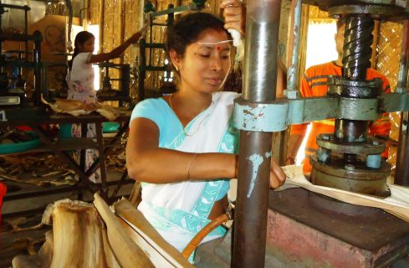
Why do we need Mudra Bank? Ans. So aspirants can be harassed with one more current affairs topic.
MSE: >5.5 cr units
40% export
>60% owned by backward classes
Need working loans 50k-10L
But only 4% can access formal FI ☹
Notes:
Total >5.5 crore units
40% export contribution
62% owned by SC/ST/OBC
Need small loans: 50k-10L
Only 4% can get through formal lenders (Bankers, NBFC, MicroFin)
Need addl. 80 Billion$ credit supply

Slide 24



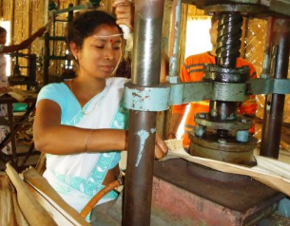

Budget-2015
Banks, other NBFCs (14%)
Bandhan
Ujjivan
SHG, MSE 24%
Microfinance Companies
Mudra Bank to regulate & refinance MFI-> MSE

Slide 25
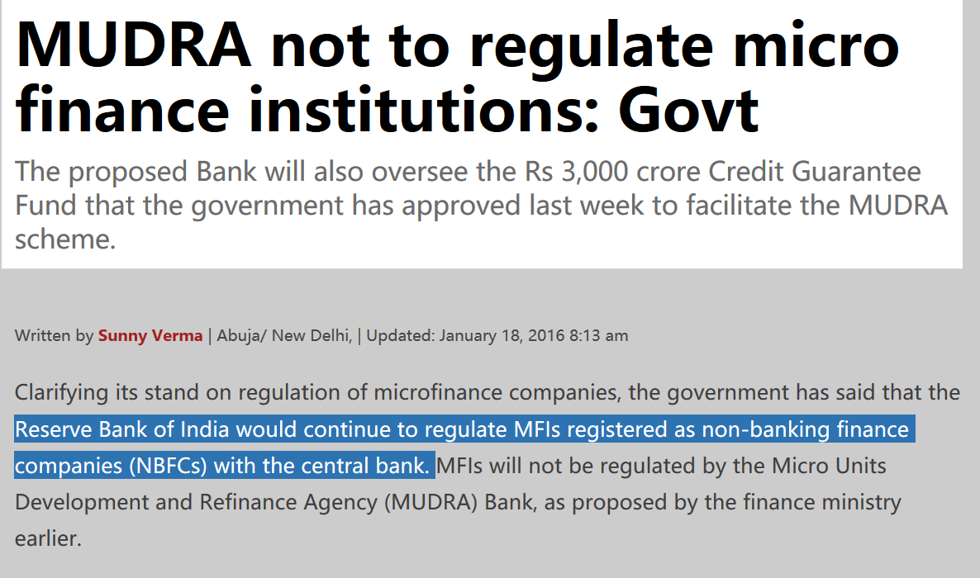
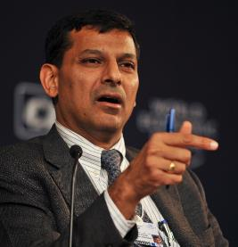
क्योकि इस तरह कोई भी ओंगी-पोंगी संस्थाओ को हमारा रेगुलेटरी पावर नही दे सकते. क्योकि डर खतम तो इज्जत खतम. मुद्रा बेंक किसी को क्या रेग्युलेट करेगी...उसे तो हम खुद 'रेग्युलेट' करेंगे.

Slide 26

Micro Units Development & Refinance Agency Ltd. (MUDRA)
Beginning: Indian Mudra not the 1st in world
1990: Bangladesh Palli Karma-Sahayak Foundation (PKSF).
Announced in Budget 2015
Structure
Function
HQ: Mumbai, Bank….X.. RBI registered as NBFC- ND
Micro enterprises-> develop, Financial literacy, training
Give last mile loans via SCB, RRB, Cooperatives, MFI etc.
RBI’s order: PSL shortfall-> 20k Cr. Mudra refinance fund
Direct lending nahi INDIRECT Lending.
100% subsidiary of SIDBI (Rs.750 cr) [Law is pending.]

Slide 27
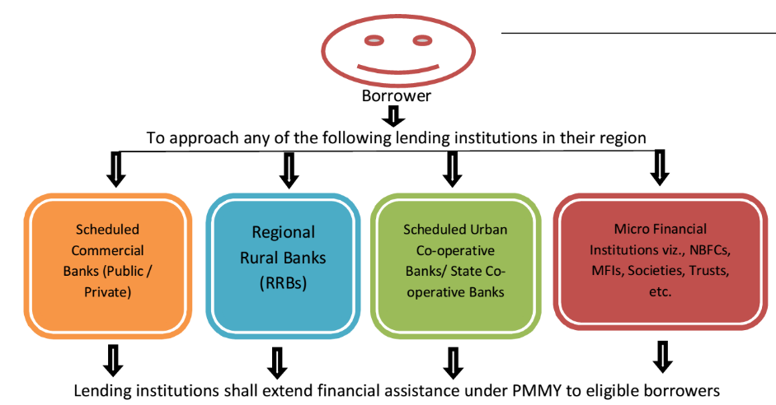

Micro Enterprise?
mfg: Investment in plant machinery 25 lakhs
Service: 10 lakhs
Shishu Loan
Tarun
Kishor
Upto 50k
>50-5 L
>5-10L
Overdraft
5000/- JDY
Loan via “MUDRA DEBIT CARD”
Loan interest : entity will decide, should be “REASONABLE”.

Slide 28




RBI has fixed spreads…making MUDRA unattractive ☹
MUDRA
Min. 10% for NBFC
Sriram Transport fin.
Max. spread 10% for NBFC
Bulldozer
“MUDRA” loan @20%
मुद्रा बेंक किसी को क्या रेग्युलेट करेगी...उसे तो हम खुद 'रेग्युलेट' करेंगे.
Hence “unattractive” for both NBFC and borrower
Notes:
http://www.moneylife.in/article/mudra-banks-refinance-scheme-is-a-non-starter-says-religare/43496.html

Slide 29

MUDRA
RBI fixed “Spread”: unattractive for NBFC, MFIs to approach MUDRA bank.
Banks: TBS “overcautious in lending” to MSME.
Duplication of Efforts vs. AIFI [EXIM, SIDBI helping MSE]
Why not reform SIDBI?
+ RBI has created “Small finance Banks”. <lecture Link>
Shell companies: fake loans, NPA
Criticism
can't become "Kunji" because too expensive.
क्या अगर वित् मंत्रालय वाले RBI का “मुद्रा बेंक” को दिलवाने की 'गुस्ताखी' नही करते, तो शायद RBI इतने कडक नियम नही बनाती? सोचने का विषय है.
Moral of the story: Aag, Paani and RBI से मत खेलना! [WRT- Bank employee union demand for Urjit Patel resignation Post-Demonetization vs. tightening of PCA Framework ;-) ]

Slide 30

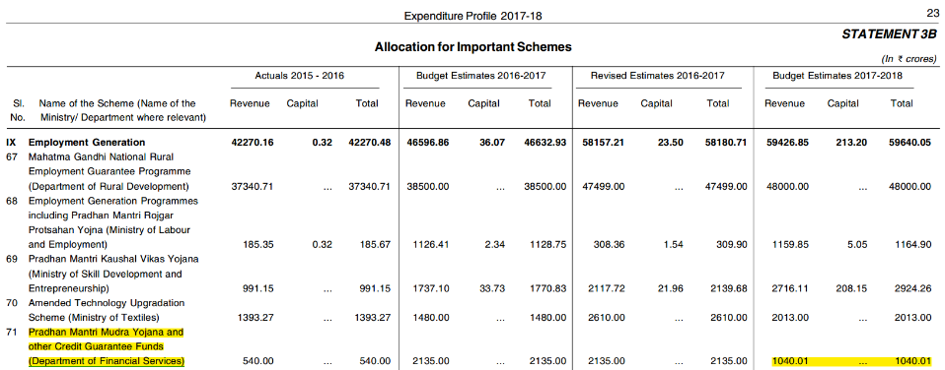
PM Mudra Yojana “TARGET”
Rs. 2.44 Lakh Crore: [2x than before]
Remember dept for prelim- same responsible for PM Jan Dhan, Atal Pension, PM Jeevan Jyoti, Surakha Bima also.

Slide 31

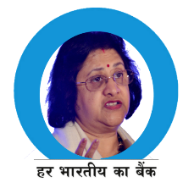



MUDRA provides “refinance” via “securitization”
Unused PSL funds directly give…
“Refinance”
Mudra credit guarantee scheme for Micro Unit
Rs.3,000/- under SIDBI’s> separate company “National Credit Guarantee Trust Corporation”.
bonds
Notes:
કમ્પ્ની ફેલ જાય તો બોન્ડ ના પૈસા કોણ આપે? ક્રેડીટ ગેરંટી.
PSL shortfall-> RIDF/ SEDF
200 cr-> MUDRA Refinance fund
750 Cr. Sharecapital
Bank: +3.5% margin
“securitization” of old loans

Slide 32
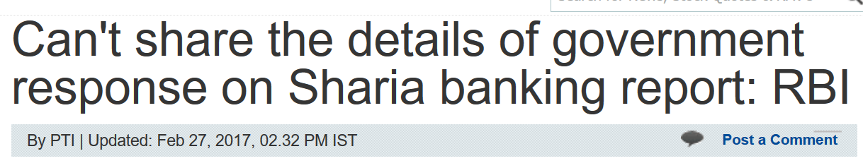


Slide 33

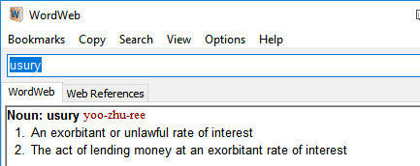
Islamic Shariya Compliant Bank
Muslim can't DO following:
invest money in speculative trading, gambling,
Alcohol or pork related biz.
Pay or receive interest.
counter: usury is prohibited. (high interest rate). but SA/FD = fixed interest rate. even the Islamic Republic of Pakistan allows.
Meaning

Slide 34
Islamic Banking and investment principles
How does it work?
Deposit-> don't give interest
iJARA-> Deposit of Client-> to Bank -> Purchase asset-> rent -> transfer to client.
Loan (Murbaha): client (home loan)-> bank buys house-> client repays @marked up price in installment.
Joint investment: (Musharaka)-> Client (biz. loan)-> share profit with bank. (VC-NBFC; Mutual fund)
Deposit
Bank Spread
Credit

Slide 35

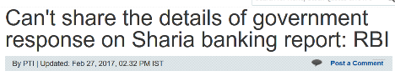
Islamic Banking / investment
In India?
2008: Rajan Committee "Interest free banking". Kerala Government tried but HC case.
2014: SBI's Shariah Equity Mutual Fund: clients' money invested in sharia compliant cos. [alcohol, pork, debt..x]
2016: RBI gradual manner because complex issue, manpower.
may be an NBFC?
$2 trillion. if Indian Islamic bank setups branches abroad-> channelize money in Indian economy. [Iran can’t channelize to West..but can, in India]
Notes:
Low debt : equity ratio.

Slide 36
Mock Question
Which of the following entities are not yet given permission in India?
Islamic Banks
Shariyah Compliant Mutual funds
Custodian Banks
Answer Choices
a) Only 1 and 2 (b) Only 2 and 3
c) Only 1 and 3 (d) All of them

Slide 37


Slide 38
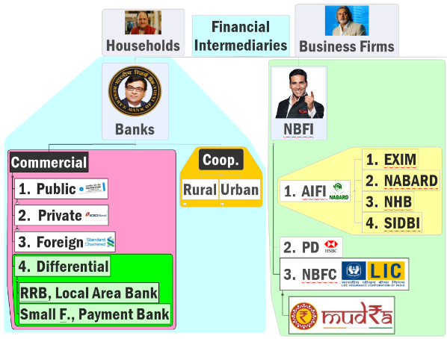

Financial Intermediaries
Regulated, Formal
Unregulated, informal
Indigenous banker
Moneylender
Financial Broker

Slide 39
Unregulated credit agencies
Moneylender [18-36-100%]
Own funds. Cash transactions (Hundi, Commercial Paper);
Finance broker [commission]
Arrange meeting between borrower & lender [black money- politicians, police].
Indigenous banker [18-36%]
Part of the money is mobilized from public: 1) Hundi: bill of exchange; 2) Commercial bills (like T-bills);
Cost lower because don't have to CRR, SLR; NPA lower (intelligence higher).
Local and segmented so money doesn't reach everywhere: CBS, E-Banking.
Since medieval times: Shroff, Shikarpuri, Chettiar, Marwari, Aiyar, Rastogi..
Kabuli Pathan, Quistwala, Arhatia, Village bania, Soni, Mahajan & Seth.
1980: Bombay alone Shroff + Marwari = >1500 cr.
NPA low because intelligence + Strong arm tactics.
Notes:
Jobbers- moneylender.

Slide 40
Mock Question
A) Informal lenders are harmful for financial inclusion.
R) Informal lenders’ NPA is lower than that of PSB.
-----------
Both right but R doesn’t explain A, informal lenders usury + strong arm tactics= hurt financial inclusion.

Slide 41

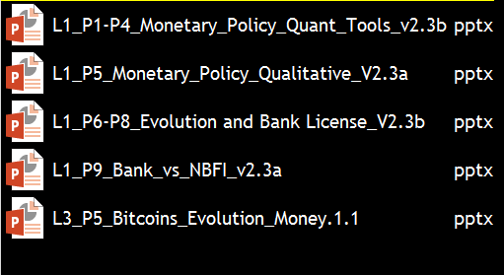
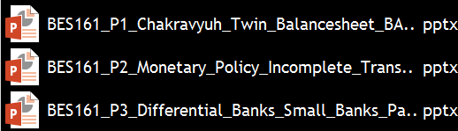
Old material is “DEMONETIZED” and “Decontentized”

Slide 42
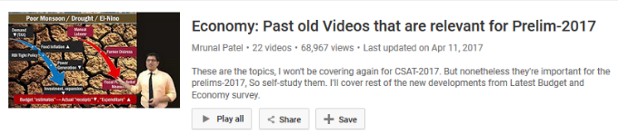

On YouTube: This is third “season” of my Prelim lecture series:
Advantages
To me: time and energy to bigger projects in future
To you: less time and energy to cover economy in subsequent attempts | Non-UPSC Exams.
Subramanian got 2 years extension till 2019. so next two years, I will have “LESS workload” ;-), if I unclutter & organize the “things” now.
Carry forward
Paris summit
RE energy
BES17
BES16
“L”
1
2
3
4
5
6
7
8
1
2
3
4
5
6
1
2*
3
4
5
6
BES19
BES18
How is census calculated?
Urea subsidies
MSP…
“L” series = Quite long, vs. so many new developments. Hence needs to be demonetized, for ease in revision. Else “fragmented” understanding.

Slide 43



BES171: Banking, Finance & Insurance
Money Evolution
Monetary Policy
Evolution & Classification of FI
Digital Payment
BASEL, NPA, TBS, Bad Bank-PARA
Finance, Insurance & Fin. Inclusion
~3.5 HRS

Slide 44

Economy: 6 pillars + theory + current + BES17 (pre cum Mains)
1.Banking, Fin, Insur.
6.HRD
2.Budget
3.BoP
4.Sectors
5.Infra
V1:c3,4
V1:c2,3, 6,9,11(GST),13
V1c:5
V1c:7(Textile),11(trade)
V1c:10
v1c:12, 14; Budget^Rail
~3.5 HRS
~6 HRS
~2.5 HRS
~3 HRS
~1.5 HRS
~1.5 HRS
so when will the “syllabus” be over?
Ans. After 18 hrs of teaching. | ~2.5 weeks before prelims

Slide 45
Why it is so late? Ans. Because I was busy in
Seasonal work in UPSC mock interview industry.
Seasonal work as Prelim faculty in physical classes.
<because these seasonal work, can't postpone 'them'>
IT / E-commerce Start up “bubble” is saturating. So online sales-commission rates %, ad-revenues etc. give “diminishing rate of return” even with more and more content.
Two years back, those who were making >40k a month back, are now struggling to earn even 10k a month.
Hence you’d see “E-Learning” sites trying to sell mocks, PDFs, online-class subscription, lecture DVDs and pendrives etc.
but there too piracy =not so lucrative for the time & efforts involved. ]-> so, slowly all are reverting to “Physical Coaching” Model.
BES17 lecture series

Slide 46
Why it is so late?
None can teach 100% free [coz IT Ecommerce Startup bubble diminishing]. Some creators ask direct money upfront. I’m not doing that-> so, I’ve to “engage” in other activities.
If I could financially sustain by just doing “website” and “Youtube” for the rest of my life, then I would’ve finished series at "faster pace” with undivided attention. <possible to make lakhs of rupees in comedy, cooking, movie review & item-songs-walli YouTube channels, not in ‘education’ channel, because audience base is narrow!>
Not that I’m complaining, or making excuses. BES17 will be finished ~2.5 weeks before prelims. PPT itself is ‘revision note’. So sufficient time is there. No need to panic. ☺ Have patience and “Empathy (GSM4)”.
BES17 lecture series

